Slide 1
AI ML Project Kickoff
Notes:
Intro to our project. We’ll flesh out the details and get to work on learning about the technical details.

Slide 2
Today’s Agenda
Discuss/vote on the overarching goal of the machine learning project
Software details (programming language and library)
Tentative Python session planning
Hardware implementation
Talk about meeting schedule
Notes:
Get the project details finalized

Slide 3
AI Image Goals

Slide 4
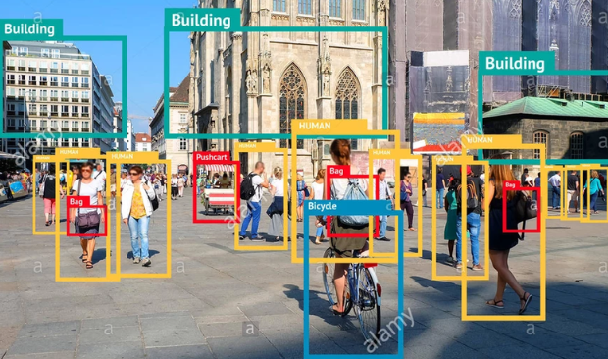
Possible Goals
Fruit Ripeness
Skin Conditions
Human Faces
Object Tracking
Other Suggestions
Notes:
I’m thinking we can hold a vote to see what people want to do. We’ll also take suggestions about other possible topics. Basically write each idea on the board, then have people raise their hands for what they want.

Slide 5

Python
Python is a high-level, general purpose programming language
Widely taught as an introductory language and used commonly with machine learning
In particular, the libraries (collection of resources and tools that can be imported) are quite helpful
The library that we will focus on is scikit-learn
Notes:
If everyone knows Python already, we can skip this.

Slide 6

scikit-learn (Python)
Notes:
Ask how many people in the audience have experience with Python

Slide 7
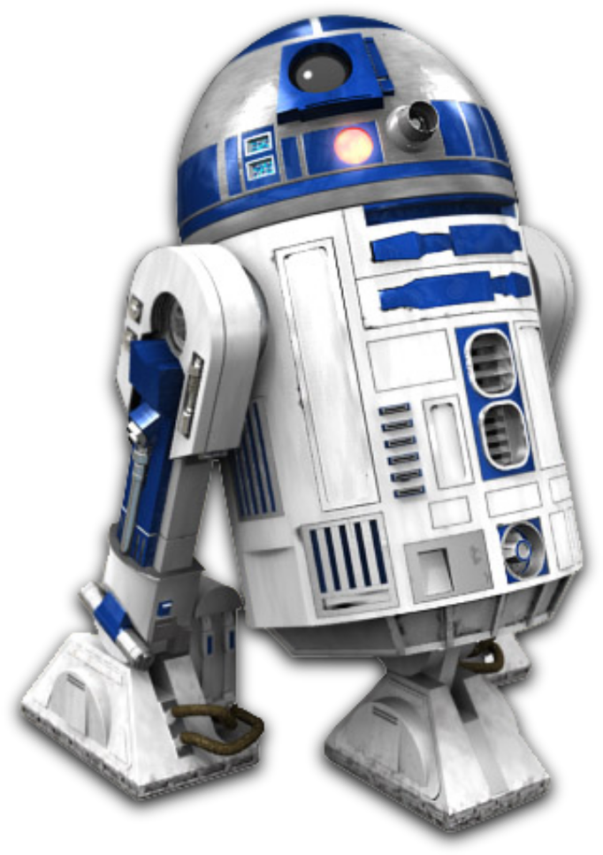
What is scikit-learn?
Free open-source machine learning library for Python
Designed to operate with the numpy and scipy libraries
Features various algorithms including classification, regression, and clustering
Operates on a simpler level; no deep learning
https://scikit-learn.org/stable/supervised_learning.html

Slide 8
Potential Python Workshop
Notes:
We can pitch this tonight, and if enough people think this would be helpful, we can hold an introductory/refresher course. Basically, if we get enough hands, we can set a workshop for next week where we’ll go over the basics of Python and libraries and stuff.

Slide 9

Image processing
In regards to image processing, scikit-learn functions by first turning images into a processable format (arrays, graphs, etc)
After processing, it can feed the data into an algorithm and begin training
Sample here: https://kapernikov.com/tutorial-image-classification-with-scikit-learn/

Slide 10

Relevant Steps/Modules
Preprocessing (sklearn.preprocessing)
Feature Extraction
Classification Models (sklearn.linear_model, etc)
Model Selection and Tuning (sklearn.model_selection)
Evaluation Metrics
Notes:
Preprocessing would be processing the images beforehand to make data scaled/normalized, ensuring fair “treatment” for every image.
Feature extraction is converting raw images to processable data. One common approach might be to flatten an image into a 1D array.
There are multiple classification approaches that can be used, such as the following: Support Vector Machines (SVM), Logistic Regression, Random Forest, K-Nearest Neighbors (KNN), MLPClassifier. Don’t need to mention all of these, just that there are options.
Model selection and tuning can basically evaluate models and help “tune” it to be more effective. It can split into test and training data, evaluate a model across multiple parameters, etc.
Evaluation metrics shows how effective the model is overall, such as % correct, prediction errors, and so on.

Slide 11
Embedded Systems Hardware

Slide 12
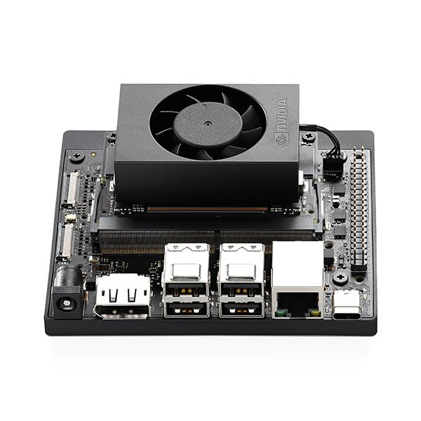
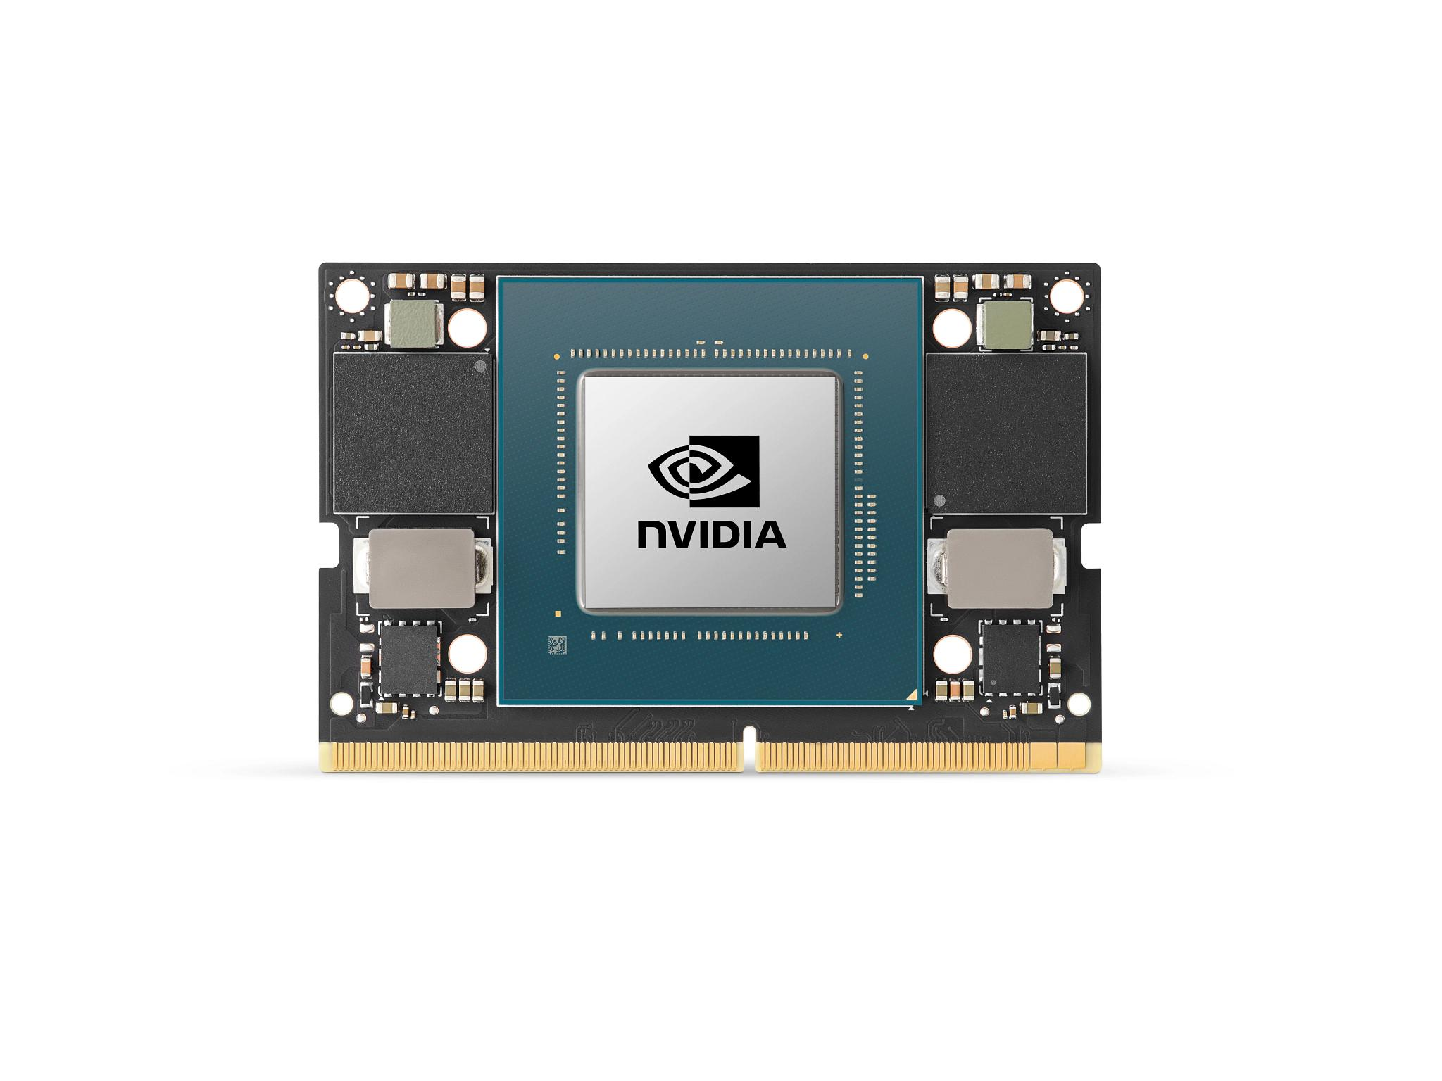
Peripherals
We have: module (chip), webcam
We need: Carrier Board, Power Supply, Cooling Fan, User Interface (Display, speaker, etc)

Slide 13
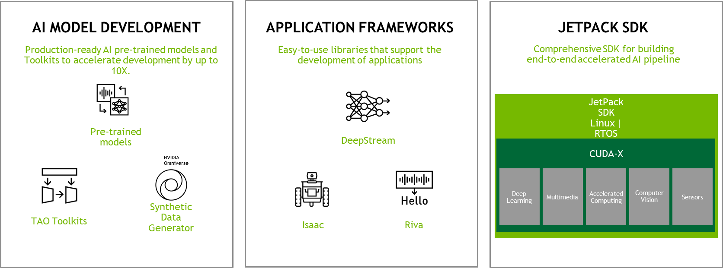
Firmware
We will be running JetPack 7
Nvidia’s RTOS built on Ubuntu LTS Linux
We will teach you how to work with Linux

Slide 14
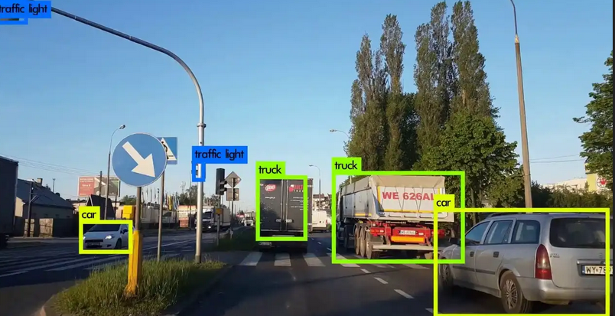
Hardware Integration
We will look at frameworks like OpenCV to get the webcam to work with the Jetson Orin Nano

Slide 15
Software Integration
Get our ML algorithms to run on the hardware!
Everyone’s work comes together here!

Slide 16
Next Steps
Review Python and scikit-learn
Prepare a possible Python workshop
Review the Github (no need to go in depth)
Set up groups and assign tasks
https://github.com/scikit-learn/scikit-learn/tree/main

Slide 17
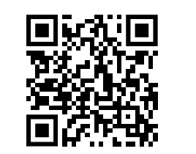
Meeting Times
https://www.when2meet.com/?32863424-FaB1k
We may meet twice a week depending on availability
Questions?
Notes:
Please fill out the when2meet; we will potentially schedule a second meeting time depending on availability.

Slide 18
Thanks for coming!

